Slide 1
Protein Secondary Structure Prediction
By J. Jedediah Smith

Slide 2
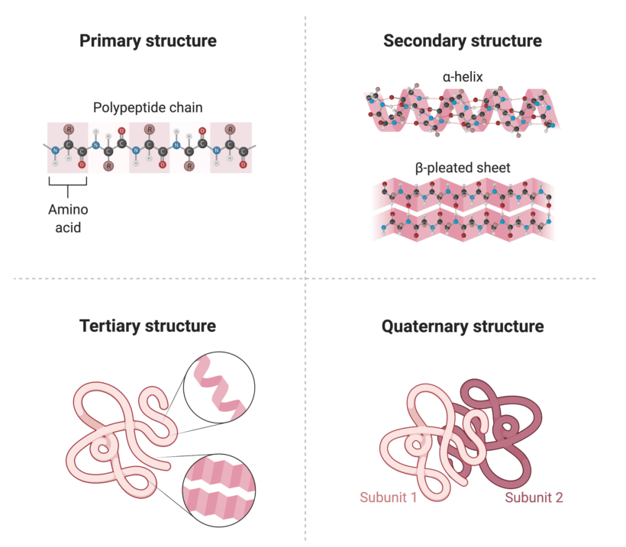
What is Protein Secondary Structure?
The spatial arrangement of amino acid polypeptides
Three standard secondary structures: helix, sheet, turn
Each type can be subdivided into different variations
Left-handed vs right-handed helix
Alpha-like vs beta-like turns
Two different notations
SST-3 labels only the three base structures
SST-8 attempts to quantify the different variations too
https://www.rapidnovor.com/protein-structure-and-how-to-study-it/

Slide 3
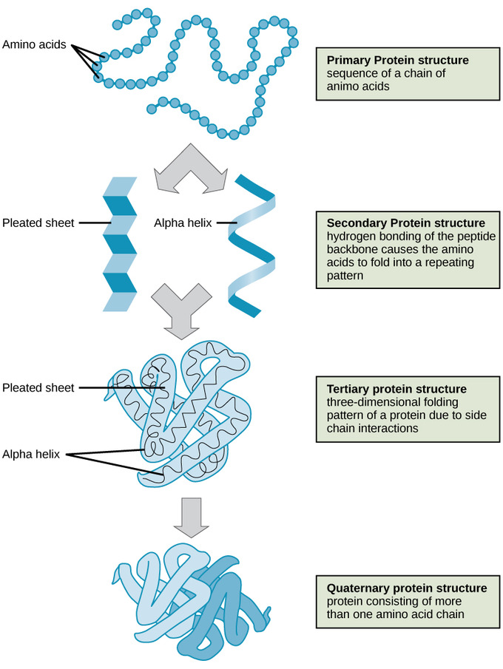
Why Study Structure?
Structure dictates function
Easier to know how a protein will work if its structure is known
Folding patterns are not random
Influenced by the amino acid residues that comprise them
Complicated and time consuming to fold proteins manually
Better to predict structure using AI or machine learning models, like ChatGPT
The first layer to predict is secondary structure
https://www.khanacademy.org/science/biology/macromolecules/proteins-and-amino-acids/a/orders-of-protein-structure

Slide 4
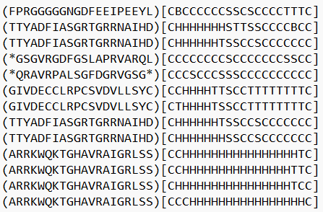
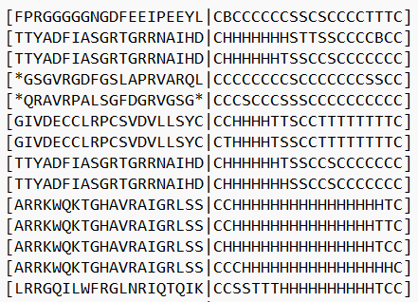
Preparing the Data in R
Format A
Used a protein dataset freely available on Kaggle, provided by Dr. Bindewald
Selected the amino acid and secondary structure columns
Saved one set with SST-3 notation, and another with SST-8 notation
Trimmed out sequences <20 amino acids
Reformatted the data into a form that would work with the ChatGPT model
Format A: (AA)[SST]
Format B: (AA|SST]
Format B

Slide 5
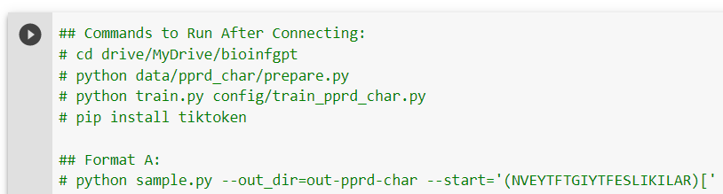
Running the Model
Set up the ChatGPT model to run on Google Collab, ran from terminal
Required Pro subscription to access the terminal window & premium GPU
Picked a single 21-length sequence for the model to predict
Ran sets of 10 predictions at training iterations of 5, 10, 50, 100, and 500
Produced lots of output, took the first 21 characters of each prediction
Format B and SST-3 tripped errors, was not able to resolve
Used Format A with SST-8 for data collections
Converted SST-8 predictions to SST-3 using a method suggested by Dr. Bindewald

Slide 6
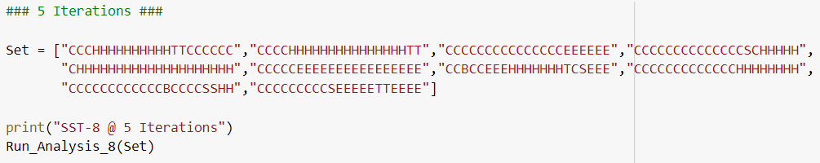
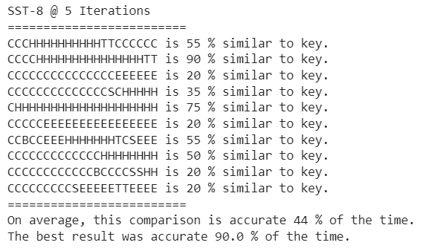

Slide 7
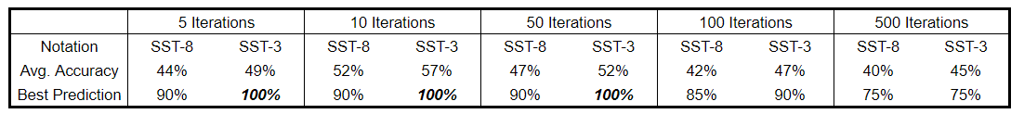
Model Results
Assessed with the average accuracy of each set of 10 predictions
Also noted the most accurate prediction of each set
The simpler SST-3 notation performed better than SST-8 in every case
Highest accuracy 57% at 10 training iterations
Accuracy appears to drop past 50 training iterations
Several sets had a 100% prediction

Slide 8
Conclusions
It is possible to predict protein secondary structure with a Chat GPT model
An accuracy of 52% or 57% may seem low, but it is much actually very good
12.5% chance to correctly guess 1 in 8 (SST-8)
33% chance to correctly guess 1 in 3 (SST-3)
The correct sequence was also predicted on three separate occasions.
1.1e-19 or 9.5e-11 probability to correctly guess 21 times in a row for SST-8 and SST-3 respectively.
I think it would be worth further refining the model to help optimize it.

